Slide 1

UNIX - Fundamentals
7
Simple Filters
9
SED
5
The shell
cmp comm diff head and tail …
Inserting
Updating
Deleting
RegEx….
1
UNIX Intro
3
Unix File System
Pattern matching
Escaping Redirecting…
The UNIX OS
The Linux OS
Features of Unix
The file
pwd and cd
mkdir
ls and cp ..
Shell Programming
8
GREP
10
6
The Processes
The character class
The *
The Dot…
condition eval
loops
read
exit status
4
Vi/Vim editors
ps nohup at and batch
2
Unix Commands
Input mode
Saving text
Aborting…
command basics
man
echo
printf …
Biz Nigatu
Software Engineer and Instructor
reckonedforce.com
@bizNigatu

Slide 2
Section 9 – UNIX Fundamentals
awk Preliminaries
Using print and printf
Redirecting Standard Output
Number Processing
Variables and Expressions
The Comparison and Logical Operators
The -f Option: Storing awk Programs in a File
The BEGIN and END Sections
Positional Parameters
Arrays
Built-In Variables
Functions
Control Flow-The if Statement
Looping with for
Looping with while

Slide 3
Chapter 12 - *** Filtering and Programming with AWK

Slide 4
AWK
‘awk’ was created in 1977 and is named after its creators: Aho, Weinberger, and Kernighan
It was later enhanced and called ‘nawk’ for New AWK
Then came ‘gawk’ for GNU AWK which is found on Linux (still called ‘awk’)
AWK was the most powerful scripting language until Perl
‘awk’, like ‘sed’, combines the features of several filters and has its own unique features
Can solve complex text processing tasks with a few lines of code

Slide 5
AWK
The POSIX specification is based upon ‘nawk’
‘awk’ accepts extended regular expressions (ERE) and, like ‘bc’, can do computations
Was designed for text processing
Data extraction
Reporting
PERL uses most of the AWK constructs
If you feel comfortable with SED then you will feel comfortable with AWK
The AWK syntax resembles ‘find’:
awk <options> ‘selection_criteria (action)’ <file(s)>

Slide 6
Versions
AWK – original from AT&T (really old)
NAWK – (new AWK) – improved version from AT&T
GAWK – GNU AWK (maintained by the Free Software Foundation)
We use AWK; must install GAWK
Fully compatible with AWK and NAWK
Text processing
Producing formatted text reports
Performing arithmetic operations
Performing string operations
etc.
Uses

Slide 7
AWK Basics
AWK was designed for small programs such as 1-3 lines of code
AWK syntax:
‘pattern { action }’
‘pattern { action }’
…
The pattern specifies when the action is performed
AWK is line-oriented; if condition is TRUE, then action is taken
The single quotes protect the program from the shell interpreting the $
Only two types of data in ‘awk’: numbers and strings of characters
Expressions separated by a comma in a ‘print’ statement are, by default, separated by a single blank when they are printed

Slide 8
AWK Basics
AWK understands that special characters follow the ‘\’
\n
\t
AWK understands $1, $2, etc. EXCEPT instead of meaning files, this mean fields of input files
An awk program may be supplied on the command line, but it’s much more common to place it in a text file and specify the file using the -f option
An awk program is a list of one or more commands of the form [ condition ] [ \{ action \} ]
where condition is either the special token BEGIN or END or an expression involving any combination of logical operators, relational operators, and regular expressions

Slide 9
AWK Basics Continued
Where action is a list of one or more of the following kinds of C-like statements, terminated by semicolons:
if (conditional) statement [ else statement ]
while (conditional) statement
for (expression; conditional; expression) statement
break
continue
print [ list of expressions ] [ expression ]
printf format [ , list of expressions ] [ expression ]
next (skips the remaining patterns on the current line of input)
exit (skips the rest of the current line)
{ list of statements }
action is performed on every line that matches condition. If condition is missing, action is performed on every line. If action is missing, then all matching lines are simply sent to standard output.

Slide 10
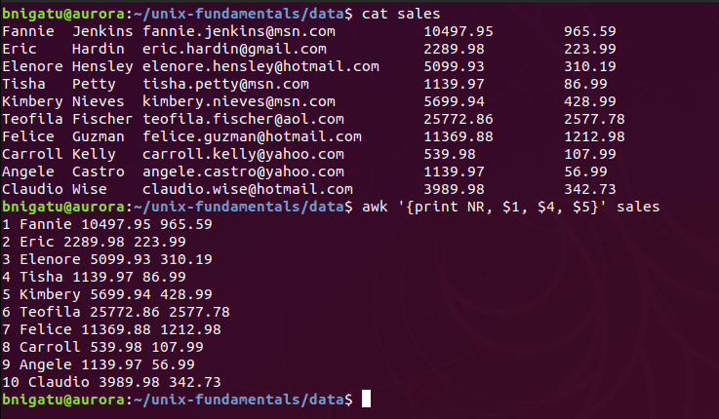
‘awk’ Accessing Individual Fields
$1 = the first field of the current line may be accessed by
$2 = the second by $2
$0 = the entire line.
NF = a built-in variable is equal to the number of fields in the current line.
NR = to represent the record/ line number.
print and printf statements to write to standard output. printf produce formatted stream.
Example: from sales file print NR/ record number, $1 = first name, $4= sales amount, $5 = sales tax

Slide 11
Fancier Output using printf
The print statement is for quick and easy output
To format the output exactly the way you want it, you may have to use the printf statement
‘printf’ statement syntax:
‘printf (format, value₁, value₂, …, value_{n})’
format is a string that contains the text to be printed verbatim, interspersed with specifications of how each of the values is to be printed
A specification is a ‘%’ followed by a few characters that control the format of a value
There must be as many % specifications in format as values to be printed
‘printf’ derived from the C programming language

Slide 12
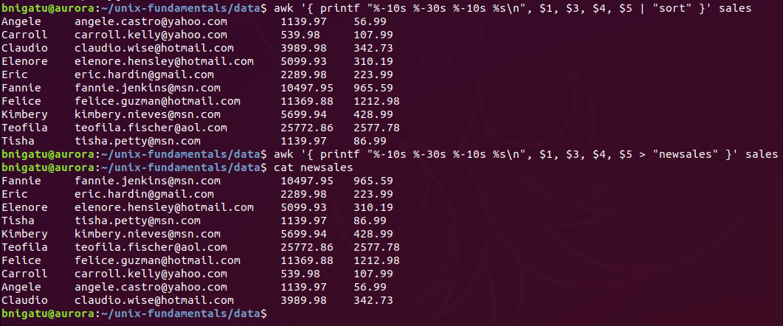
‘awk’ Redirecting Standard Output
Every print and printf statement can be separately redirected with the > and | symbols. However, make sure the filename or the command that follows these symbols is enclosed within double quotes.
Redirecting to sort
Left justified 10 characters
Redirecting to new file

Slide 13
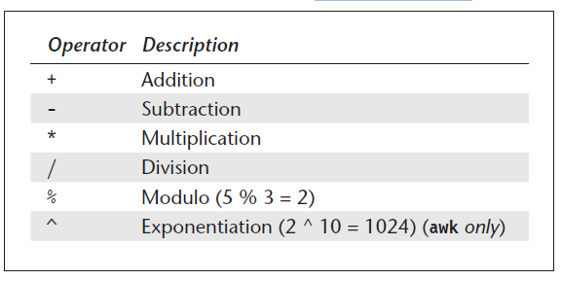
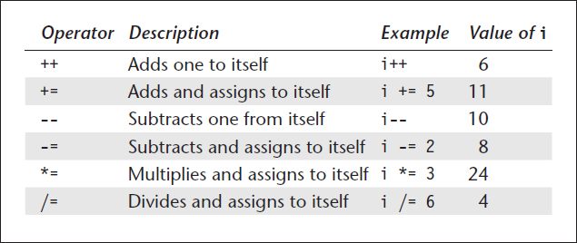
‘awk’ Number Processing
Arithmetic Operators Used by awk
Assignment Operators used by awk
Assume i = 5 initially; result used as initial value by next line)

Slide 14
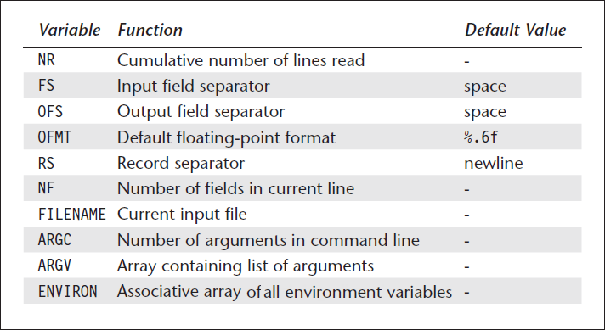
‘awk’ Variables and Expressions
awk variables have only string or a number data type, and awk makes the necessary conversion according to context. Unlike shell variables, awk variables don’t use the $ either in assignment or in evaluation. Example : x = “5” ; print x Built-In Variables in Awk
awk has several built-in variables which are all assigned automatically, though it is also possible for a user to reassign some of them.
These built-in variables are shown in the next table.

Slide 15
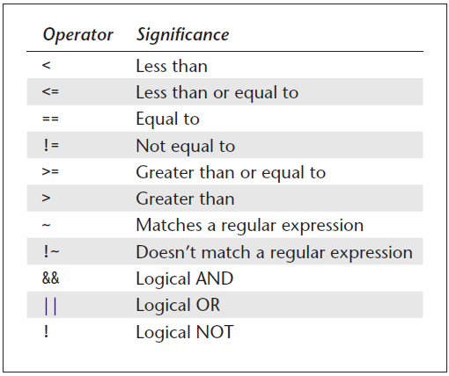
‘awk’ Comparison and Logical Operators
Both numeric and string equality are tested with the == operator. The operator != tests inequality.

Slide 16
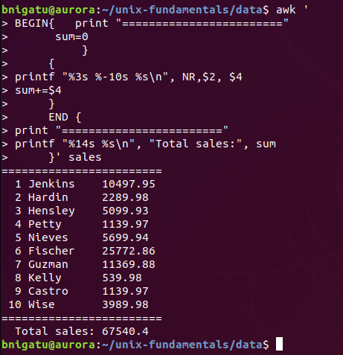
‘awk’ Begin and End
awk 'BEGIN{ statements } { statements } END { end statements }'
BEGIN is triggered before awk read the first line,
END is triggered after the last line has been read.
When expressions are listed in a print statement, no space is placed between them, and a newline is printed by default.
All blocks of awk are optional.
Example: Displayed the customer first name and sales amount of every line every line and print the total sales amount at the end.
Example: is found in script folder and execute as /script$ bash awk_begin_end.sh ../data/sales
Var initialization
Print NR, first name, sales
Add sales to sum
Print total sum

Slide 17
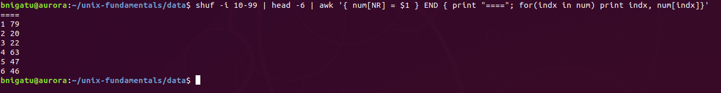
‘awk’ Arrays
An array is also a variable except that this variable can store a set of values or elements. Each element is accessed by a subscript called the index.
Arrays in awk are not formally defined. An array is considered declared the moment it is used. Array elements are initialized to zero or an empty string unless initialized explicitly.
Arrays expand automatically. The index can be virtually anything; it can even be a string.
Example: the following script display the array index and value awk '{ num[NR] = $1 } END { print "===="; for(indx in num) print indx, num[indx]}'
Generate random Numbers 10-99
Head only 6 numbers

Slide 18
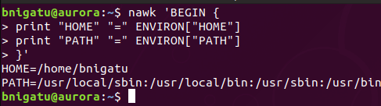
‘awk’ Environment Arrays ENVIRON[ ]
You may sometimes need to know the name of the user running the program or the home directory. awk maintains the associative array, ENVIRON[ ]
Example: To access the shell variables, HOME and PATH. nawk 'BEGIN {
print "HOME" "=" ENVIRON["HOME"]
print "PATH" "=" ENVIRON["PATH"]
}'

Slide 19
‘awk’ Functions
awk has several built-in functions, performing both arithmetic and string operations. The arguments are passed to a function in C-style, delimited by commas, and enclosed by a matched pair of parentheses.
User defined functions definition looks like this:
function name([parameter-list])
{
body-of-function
}
In many awk implementations, including gawk, the keyword function may be abbreviated func. However, POSIX only specifies the use of the keyword function.

Slide 20
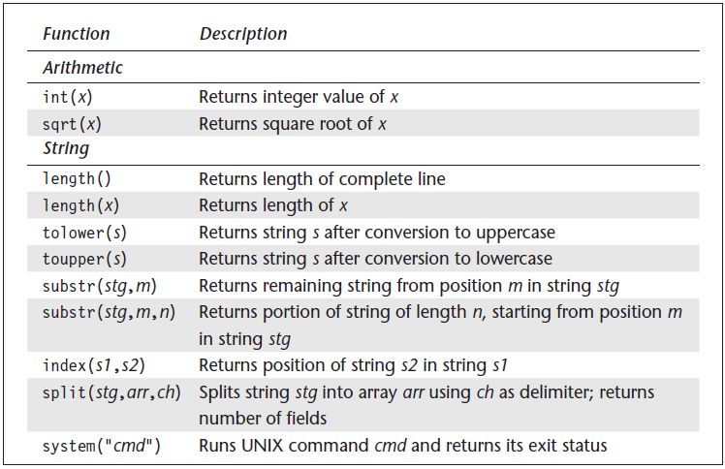
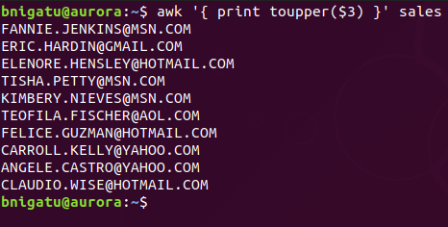
‘awk’ Built-in Functions
awk has several built-in variables which are all assigned automatically, though it is also possible for a user to reassign some of them.
Example: display all customers’ email in upper case.

Slide 21
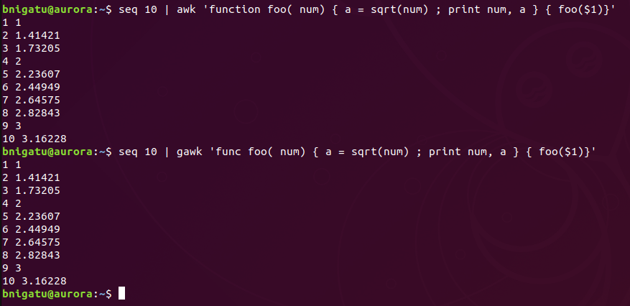
‘awk’ User defined Functions
Example: Sum sequence of 10 digits 1-10 using awk function
Sequence 10 nums
Function definition
Call function for each row
gawk takes func

Slide 22
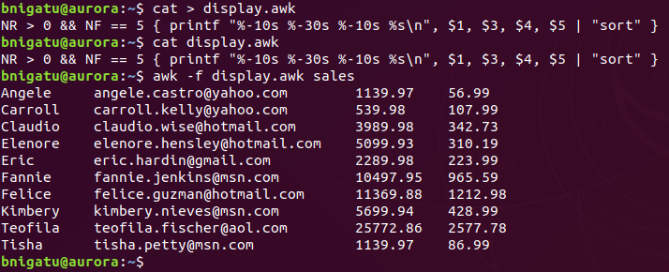
Storing awk Programs in a File (-f)
You should hold large awk programs in separate files and provide them with the .awk extension for easier identification (this is only for identification and not required by awk).
Create awk file
using –f apply awk file

Slide 23
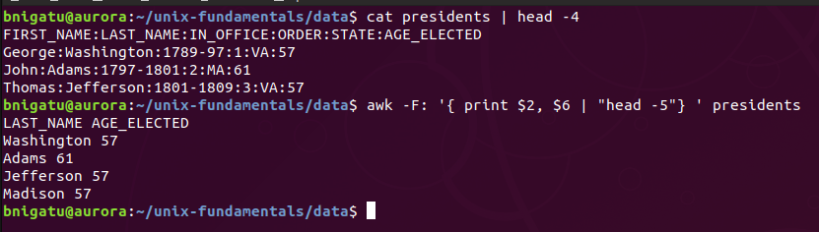
awk with files with nonstandard delimiter (-F)
-F <value> tells awk what field separator to use.
awk -F: '{print $1, $2}’ filename In this case, -F: means that the separator is :

Slide 24
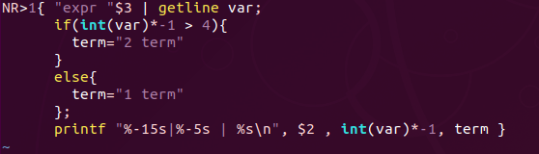
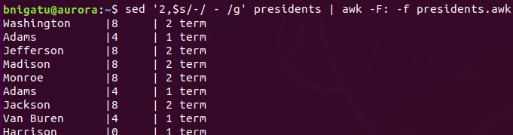
awk Control Flow-The if Statement
awk supports conditional structures (the if statement)
The statement in awk takes this form:
if ( condition is true ) {
statements
} else { #else is optional
statements
}
Sample if statement: in the presidents.awk file
The awk command given as:
sed '2,$s/-/ - /g' presidents | awk -F: -f presidents.awk

Slide 25
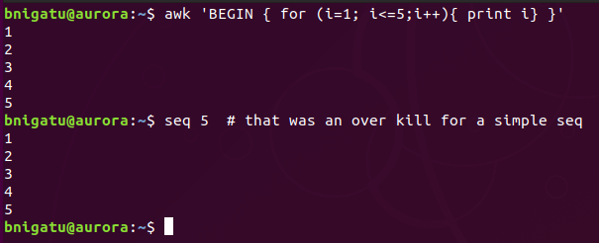
awk Looping with for
awk supports two loops—for and while. They both execute the loop body as long as the control command returns a true value. The easier one resembles its C counterpart:
for ( k=1 ; k<=9 ; k+= 2 )
A simple example of for loop given below. Please refer the Array slid for more useful for loop example.

Slide 26
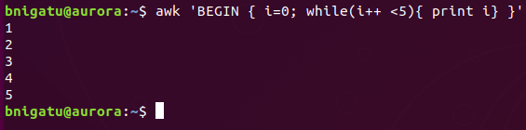
awk Looping with while
The while loop has a similar role to play; it repeatedly iterates the loop as long as the control command succeeds:
while (condition is true) {
statements
}

Slide 27
Lab (use employees.sorted)
Print the total number of input lines
END { print NR }
Print the 4th input line
NR == 4
Print every input line with more than four fields
NF > 4
Using the emp.data file, print the total number of lines that contain Beth
{ nf = nf + NF }
END { print nf }
Print the first two fields, in opposite order, of every line
{ print $2 $1 }
Write an awk program that formats the employees.sorted file such that there is a heading above the output
See first BEGIN slide from today

